Slide 1

Data Structures
Week 1 - Data Abstraction and
Big O Notation
Juan Carlos Pineda
ITESM
juancarlos.pineda@itesm.mx

Slide 2
Agenda
Personal Introduction
General Rules and Logistics
Course Overview
Information and Data
Data Abstraction and Encapsulation
Data Hiding
Data Structures

Slide 3
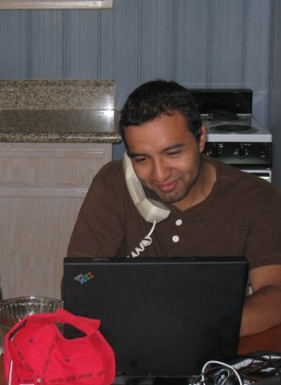
About me
Notes:
Graduation
Career start - 10,000 hour rule (Hamburg)
Career development
Current role
Facts/Hobbies, etc
Why this picture?

Slide 4
General Rules and Logistics
There's a 10 min tolerance to enter the classroom
No cell phone calls or texting during class
You can use computers but any social media, gaming and distractions are not allowed. If caught you will teach the next class
Homework will be due each Friday at midnight
We will use Schoology as the LMS and homework will be delivered there.
For each class you will be required to read the published material in anticipation for the class
Make sure to read the collaboration policy**

Slide 5
Agenda
Personal Introduction
Administrative Items and Logistics
Course Overview
Information and Data
Data Abstraction and Encapsulation
Data Hiding
Data Structures
Big O Notation

Slide 6
Course Overview
This class is about:
Data structures and data representation
Scalability
Elementary Search Algorithms
Implementations in C/C++/Java
And fun problem solving!

Slide 7
Agenda
Personal Introduction
General Rules and Logistics
Course Overview
Information and Data
Data Abstraction and Encapsulation
Data Hiding
Data Structures
Big O Notation

Slide 8
Information and Data
A computer is a machine that handles and works with information
Computer Science requires students to know how Information is organized inside a computer, how it's handled and used
Then…. What is information?

Slide 9
Information and Data
The single most piece of information in a computer is called a bit
A bit can only have 2 values: 1 and 0
So, the computer is in essence a binary Information System
The physical memory of a computer is organized in Bytes, which are 8-bit long segments of information
Most of the information stored in a computer is then saved in bytes

Slide 10
Data Types
A set of bits might represent a character (e.g. ‘A’), a digit (e.g. 23) and so on
A Data Type is the mechanism that computer programming languages have to interpret that set of bits
Common Data Types: int, char, double

Slide 11
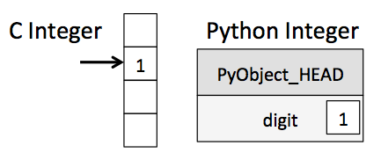
Memory Allocation
Bits are saved in memory as a group of bytes called “words”
Every such word has an address or location
Example:
When we declare a variable in C/Java
int x = 1;

Slide 12
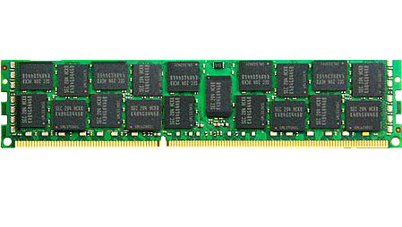
j | c | p | i | n | e | d | a | \0
Notes:
IDE demonstration of an array

Slide 13
Basic Data Structures
In Java and C there are two basic data structures that can be constructed:
Arrays
Structs and Classes

Slide 14
Agenda
Personal Introduction
General Rules and Logistics
Course Overview
Information and Data
Data Abstraction and Encapsulation
Data Hiding
Data Structures
Big O Notation

Slide 15
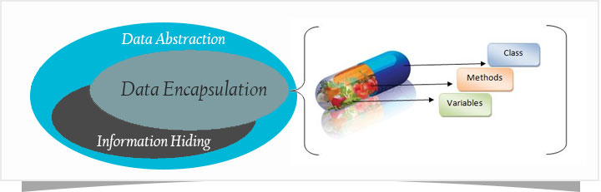
Data Abstraction
"What’s in a name? That which we call a rose/ By any other word would smell as sweet. " - Shakespeare
Abstraction is the ability to understand something from a high level, not looking into the details
Seeing something from outside
Examples: Organizations, body organ a computer program, ,driving a car
Notes:
Ask a Student to come up with an example.
Common examples: computer, cars

Slide 16
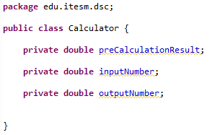
Example

Slide 17
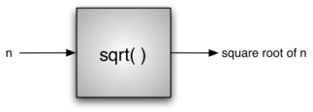
Procedural Abstraction
Abstraction of a function, where the user only knows the minimum details to use
Commands given to another entity without knowing/caring about the details or actions needed to complete it
Examples: brake pedal on a car, volume change on TV, etc.

Slide 18
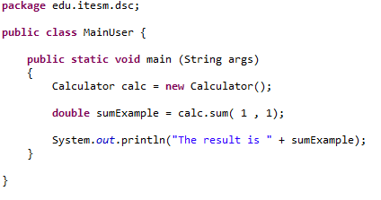
Procedural Abstraction

Slide 19
Encapsulation
Putting together related information about the same concept and controlling the outside access to it
Packaging of information and the methods used to access and/or operate with it
In Java, a class is the way to encapsulate information

Slide 20
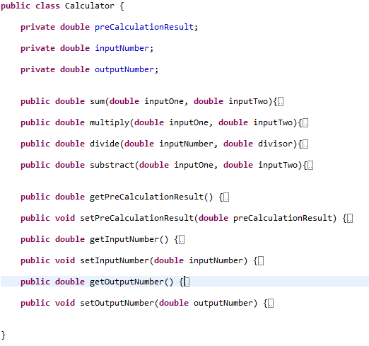
Encapsulation Example

Slide 21
Agenda
Personal Introduction
General Rules and Logistics
Course Overview
Information and Data
Data Abstraction and Encapsulation
Data Hiding
Data Structures
Big O Notation

Slide 22
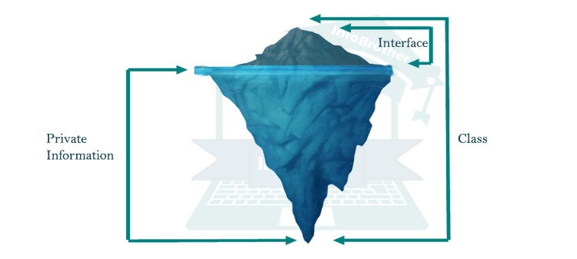
Data Hiding
Is the process used by many languages to hide the implementation details and current state of an object
Allows the user of an object to forget about the implementation details
Hiding the data we can restrict the access to the parameters of a class

Slide 23
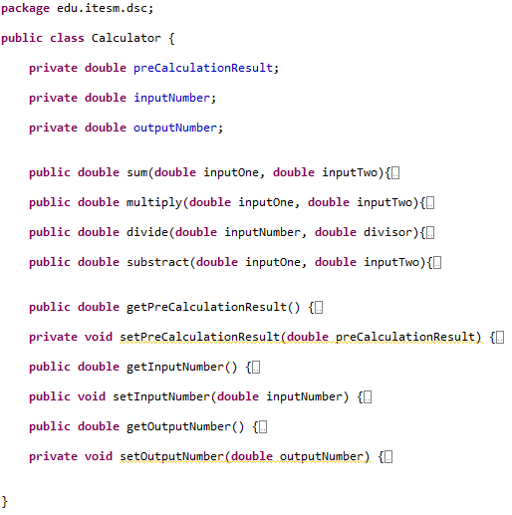
Data Hiding Example
Private class attributes
Private methods

Slide 24
Agenda
Personal Introduction
General Rules and Logistics
Course Overview
Information and Data
Data Abstraction and Encapsulation
Data Hiding
Data Structures
Big O Notation

Slide 25
Linear Data Structures
Stack
Queue
Linked List

Slide 26
Non-Linear Data Structures
Binary Trees
Graphs
Hash

Slide 27
Let’s Start with Arrays
Arrays can be seen as contiguous pieces of memory
Can be traversed using a pointer or an int
Index
0 | 1 | 2 | 3 | 4 | 5
Variable
H | e | l | l | o | \0
Address
0x23451 | 0x23452 | 0x23453 | 0x23454 | 0x23455 | 0x23456

Slide 28
Exercise
Create a program that stores your name using chars and displays it to the console
Create a program that can take an int array and returns the sum of all the elements in the array
Notes:
20 minutes

Slide 29
Bidimensional Arrays
Each element in an array can also be an array
Elements in a bidimensional array have two indexes
Say you have bidimensional array A, in order to access the third element of the first row, you access A[0][2] (zero based index)

Slide 30
Create a class to manipulate Arrays

Slide 31
Agenda
Personal Introduction
General Rules and Logistics
Course Overview
Information and Data
Data Abstraction and Encapsulation
Data Hiding
Data Structures
Big O Notation

Slide 32

Analysis of Algorithms
The best, worst, and average-case time complexities for any given algorithm are numerical functions over the size of possible problem instances. However, it is very difficult to work precisely with these functions, because they tend to:
• Have too many bumps
• Require too much detail to specify precisely
Notes:
The very same approach that scientists use to understand the
natural world is effective for studying the running time of programs:
■ Observe some feature of the natural world, generally with precise measurements.
■ Hypothesize a model that is consistent with the observations.
■ Predict events using the hypothesis.
■ Verify the predictions by making further observations.
■ Validate by repeating until the hypothesis and observations agree.
One of the key tenets of the scientific method is that the experiments we design must
be reproducible, so that others can convince themselves of the validity of the hypothesis.
Hypotheses must also be falsifiable, so that we can know for sure when a given hypothesis
is wrong (and thus needs revision). As Einstein famously is reported to have said
(“No amount of experimentation can ever prove me right; a single experiment can prove
me wrong”), we can never know for sure that any hypothesis is absolutely correct; we
can only validate that it is consistent with our observations.

Slide 33
Analysis of Algorithms
Every programmer has questions like these:
How long will my program take?
Why does my program run out of memory?

Slide 34
Analysis of Algorithms
The very first challenge is to determine how to make quantitative measurements of the running time of our programs
Our first qualitative observation about most programs is that there is a problem size that characterizes the difficulty of the computational task
Another qualitative observation for many programs is that the running time is relatively insensitive to the input itself; it depends primarily on the problem size.

Slide 35
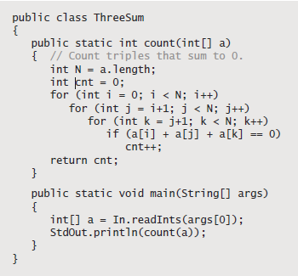
Analysis of Algorithms
Notes:
ThreeSum shown
here, which counts the number of triples in a file of N integers that sum to 0 (assuming
that overflow plays no role). This
computation may seem contrived to you,
but it is deeply related to numerous fundamental
computational tasks

Slide 36
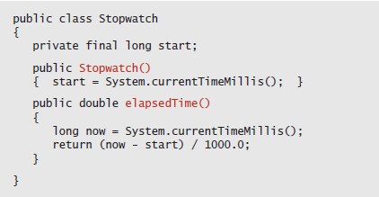
Analysis of Algorithms
Sample Stopwatch class
Notes:
ThreeSum shown
here, which counts the number of triples in a file of N integers that sum to 0 (assuming
that overflow plays no role). This
computation may seem contrived to you,
but it is deeply related to numerous fundamental
computational tasks

Slide 37
Mathematical Models
Knuth’s basic insight is simple: the total running time of a program is determined by two primary factors:
■ The cost of executing each statement
■ The frequency of execution of each statement
Notes:
In the early days of computer science, D. E. Knuth postulated that, despite all of the complicating factors in understanding the running times of our programs, it is possible, in principle, to build a mathematical model to describe the running time of any program.

Slide 38
Order of Growth Hypothesis
Property A. The order of growth of the running time of ThreeSum (to compute the
number of triples that sum to 0 among N numbers) is N ³.
Evidence: Let T(N ) be the running time of ThreeSum for N numbers. The mathematical
model just described suggests that T(N ) ~ aN ³ for some machine-dependent
constant a; experiments on many computers (including yours and ours)
validate that approximation

Slide 39
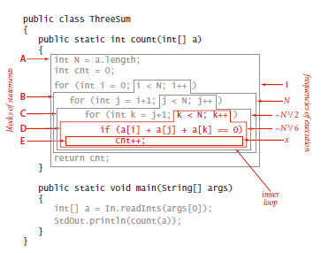
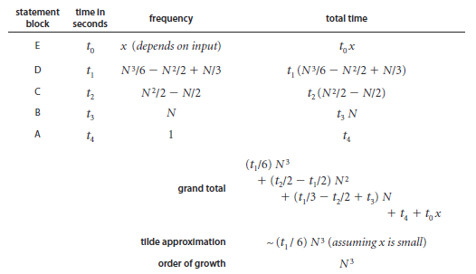
Code Analysis

Slide 40

Cost Model
We focus attention on properties of algorithms by articulating a cost model that defines the
basic operations used by the algorithms we are studying to solve the problem at hand
3-sum cost model. When
studying algorithms to
solve the 3-sum problem,
we count array accesses
(the number of times an
array entry is accessed, for
read or write).

Slide 41
Cost Model for ThreeSum
Proposition B. The brute-force 3-sum algorithm uses ~N 3/2 array accesses to
compute the number of triples that sum to 0 among N numbers.
Proof: The algorithm accesses each of the 3 numbers for each of the ~N 3/6 triples.

Slide 42
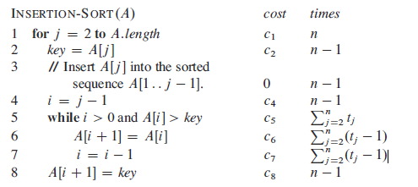
Insertion Sort

Slide 43
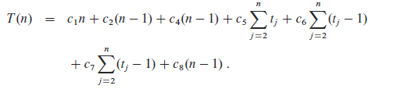
Cost Model for Insertion Sort
The running time of the algorithm is the sum of running times for each statement executed. A statement that takes ci steps to execute and executes n times will contribute cin to the total running time.
To compute T(n), the running time of INSERTION-SORT on an input of n values

Slide 44

Worst case scenario
An Algorithm’s running time may depend on which input is given
For Insertion sort, the best case occurs if the array is already sorted. Then, the running time is
However, if the array is in reverse order (decreasing order) because we must compare each element A[j] with each element in the entire sorted subarray A[1 .. j -1]

Slide 45
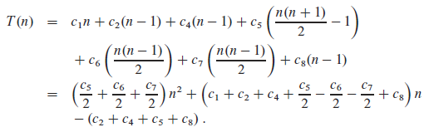
Worst case cost model

Slide 46
Asymptotic Notation
Asymptotic notation is used to describe running times of algorithms, for instance, insertion sort worst-case worst case running time is (theta of n square)
Writing the insertion sort running time as we abstract the details of the function

Slide 47

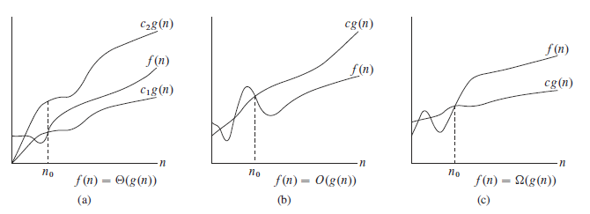
𝚹 notation
For a given function g(n)
we denote by 𝚹(g (n)) the set of functions

Slide 48

O notation
The 𝚹 notation asymptotically bounds a function from above and below. When we have only an asymptotic upper bound, we use O notation. For a function g(n) we denote O(g(n)) the set of functions
Since O-notation describes an upper bound, it is used to bound the worst case running time of an algorithm.

Slide 49
Summary
For many programs, developing a mathematical model of running time reduces to the following steps:
■ Develop an input model, including a deﬁnition of the problem size. ■ Identify the inner loop.
■ Deﬁne a cost model that includes operations in the inner loop.
■ Determine the frequency of execution of those operations for the given input. Doing so might require mathematical analysis

Slide 50
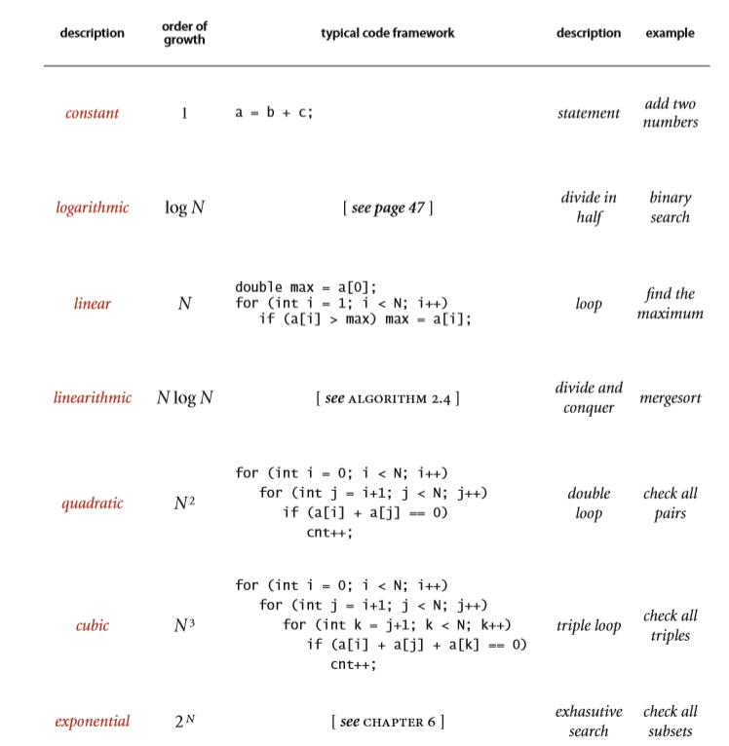
Order of growth classifications

Slide 51
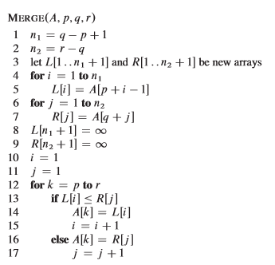
Merge Sort
The merge procedure takes O(n), where n = r - p - 1 is the total number of elements being merged

Slide 52
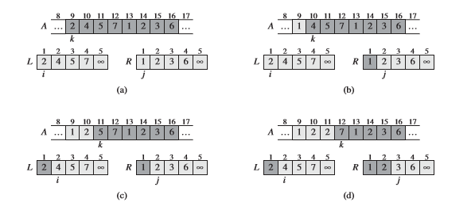
Merge Sort - Graphic Representation

